Slide 1
First Term Success Workshop
Career Planning
Notes:
FACILITATOR GUIDE:
Career Planning has many facets, setting goals and expectations for yourself will push you to be your best version.

Slide 2
Enabling Objectives
DEFINE a contract obligation, reenlistment, extension, zone of enlistments, and military obligation service (MSO)
DEFINE the purpose of CDBs per the Career Counselor Handbook, NAVPERS 15878 (series)
IDENTIFY Navy Wide Advancement eligibility per the Advancement Manual for Enlisted Personnel of the U.S. Navy and U.S. Navy Reserve, BUPERSINT 1430.16 (series)
ANALYZE Navy Wide Advancement Exam results in accordance with applicable directives
LIST eligibility requirements for commissioning programs per the Enlisted to Officer Commissioning Programs Application Administrative Manual, OPNAVINST 1420.1 (series)
IDENTIFY U.S. Navy Reserve programs in accordance with applicable directives
Notes:
FACILITATOR GUIDE:
Review objectives

Slide 3
References
OPNAVINST 1040.11 (series)- Navy Enlisted Retention And Career Development Program
NAVPERS 15878 (series)- Career Counselor Handbook
BUPERSINST 1430.16 (series)- Advancement Manual for Enlisted Personnel of the U.S. Navy and U.S. Navy Reserve
OPNAVINST 1420.1 (series)- Commissioning Programs Manual
OPNAVINST 1900.2 (series)- Transition Assistance Program
My Navy Portal, Career Planning- https://www.mnp.navy.mil/group/career-planning/ladr
Enlisted Community Manager page- https://www.mynavyhr.navy.mil/Career-Management/Community-Management/Enlisted/
Notes:
FACILITATOR GUIDE:
Review references

Slide 4
Key Terms
PRD (Projected Rotation Date) – The month and year the member is due to transfer from command (+/- 6 Months)
EAOS (Expiration of Active Obligated Service)- The specific date member’s active-duty service obligation expires
SEAOS (Soft Expiration of Active Obligated Service)- EAOS plus any inoperative extensions to enlistment/reenlistment contract
ADSD (Active Duty Service Date)- First day of member’s active duty enlistment
Contract Obligation- Minimum year or months required to complete a tour (OBLISERV- Obligated service)
Notes:
FACILITATOR GUIDE:
Review definitions

Slide 5
Contract Obligation
Length of time you are required to obligate to remain active duty (OBLISERV) per assignment.
Can be fulfilled via reenlistment or extensions or combination of the two.
Example:
SEAOS: 02/23/2025; PRD: 04/2026
Member will end active duty before they are scheduled to transfer. Member needs to OBLISERV 14 months
Notes:
FACILITATOR GUIDE:
Explain where the OBLISERV (if applicable) is located on member's orders.
Orders will state length of OBLISERV required.
Recommend referring member to Prescribed Sea Tour (Incentive 3) if there is a question regarding to the length determined vs contract obligation.
Member can also reenlist first, then execute an extension as long as the OBLISERV is fulfilled.

Slide 6
Reenlistment
Reenlistment term: 2, 3, 4, 5, or 6 years
Recommended for retention by CO (“Promotable” or above on most current evaluation)
Must be rated
Must be physically and medically qualified
Must have an approved Career Waypoints (C-Ways)– Reenlistment quota
Cannot exceed High Year Tenure (HYT)
  Waiverable
Notes:
FACILITATOR GUIDE:
Explain members must receive at least a Promotable on the most current evaluation (periodic or special) for CO’s retention recommendation.
PACT Sailors with required A-school will not be able to reenlist until they graduate from the A-school.
Member with 2 consecutive PFA failures will have to refer to NAVADMIN 043/23 (Physical Fitness Failures Reset).
CCC and Sailor update intentions on MNA to receive CWAY quota (CCC ensures Sailor is qualified in CWAY)
Explain C-Way approval quota expiration (as applicable).
Explain High Year Tenure (HYT) and HYT Plus Pilot (NAVADMIN 277/23): willing and able to take orders to a valid, vacant billet, which could include extending at the current command to reach normal tour length. If you chose to decline orders into a valid, vacant billet, you separate at HYT under HYT policy. HYT Plus is executed through the normal HYT waiver process, after orders are negotiated with the detailer.
E3 – Rated, 6 years
E4 – 10 years
E5 – 16 years
E6 – 22 years
E7 – 24 years
E8 – 26 years
E9 – 30 years

Slide 7
Zones of Enlistment
Zone A: 0 – 6 Years
Zone B: 6 – 10 Years
Zone C: 10 – 14 Years
Zone D: 14 – 20 Years
Zone E: >20 Years
Notes:
FACILITATOR GUIDE:
Review reenlistment zones.

Slide 8
Extension
Extensions can be executed for minimum 1 month up to maximum 48 months per enlistment contract
Reason for Extensions (School, PRD, HYT, Retain in service, maternity care benefits for service women or spouse, etc.)
Notes:
FACILITATOR GUIDE:
Must be recommend for retention by CO.
Explain the difference between the terms execution date and operative date.
Execution date is the date the Sailor signed the extension.
Operative date is the date the extension goes into effect; EAOS + 1 Day.
This is not an all inclusive list, see MPM 1160-040, page 4-6 for additional reason a Sailor can extend for.
An inoperative extension will be cancelled if member reenlists. The reenlistment must take them past the number of months already obligated in their previous extensions.

Slide 9
Military Obligation Service (MSO)
Personnel incur an MSO upon initial entry into the AC or RC of any of the Armed Forces. Service performed on active duty, inactive duty, or a combination of both is used to satisfy this obligation.
Service members serve in a Military Service for a total initial period of not less than 3 years nor more than 8 years, unless discharged under regulations prescribed by the Secretary of Defense or (for Navy personnel) the Secretary of the Navy (SECNAV).
Sailors enlisted prior to 1 October 2020 serve a minimum of 4 years and may complete their remaining 4 years of MSO by serving in the Selective Reserve (SELRES) or Individual Ready Reserve (IRR).
Sailors enlisted on or after 1 October 2020 fall under the 4-2-2 MSO.
  Minimum four years Active Duty (AD), followed by up to two years of SELRES and two years of Individual Ready Reserve (IRR) service.
  Serving 6 Years on Active Duty will remove the 2 year SELRES requirement
Notes:
FACILITATOR GUIDE:
Explain to First Termers their MSO can be found in their original contract located in their OMPF on BOL.

Slide 10
Career Development Boards (CDB)
Career Development Boards (CDBs) are the primary delivery method to ensure Sailors are provided guidance to make informed career decisions based on current Navy policies, programs, and procedures.
CDBs will be performed at the following intervals:
Reporting, 24-month, 48-month, and 60-months on board each duty station.
PACT Sailors’ CDBs will be performed at the following intervals:
Reporting, 6-month, 12-month, and 18-months.
Additionally, a CDB should be conducted for Advancement, Commissioning, Education, Separation, career decisions, etc. or at the request of the Sailor.
At the completion of the CDB an Individual Career Development Plan (ICDP) will be created for the member.
Notes:
FACILITATORS GUIDE:
Presenter can explain why CDBs are important in helping Sailor plan their career with assistance from their respective chain of command.
Cover the Individual Career Development Plan (ICDP)
Mutually developed plan
Assists in achievement of personal and professional goals
The Sailors' take away from a CDB

Slide 11
Commissioning Programs
Basic Requirements:
  U.S. Citizen
  Physically qualified
  Age
  Testing
  Recommended by your Commanding Officer
Naval Academy | Naval Academy Preparatory School (NAPS) | Seaman to Admiral (STA-21) | Medical Enlisted Commissioning Program (MECP) | Officer Candidate School (OCS)
Provides 4 years of college education Must be 17 and not older than 23 on 1 July of entrance year Unmarried with no legal responsibility to support others | Provides intensive preparation for the academic, military, and physical training curriculum at the Naval Academy Offered direct appointment to the Naval Academy Must be not older than 22 as of 1 July of the entrance year | Minimum 1000 SAT 41 ACT (combined Math/English) Two components: 8 weeks at Naval Science Institute (NSI) 36 months at NROTC university Receive full pay and allowances Eligible for advancement | Provides opportunity to commission in the Nurse Corps Minimum 1000 SAT 42 ACT (combined Math/English) Can be up to 42 years old Receive full pay and allowances Eligible for advancement | Must have a Bachelor's degree 12 weeks of officer candidate indoctrination and training 22 different fields available Each designator has its own prerequisites
Notes:
FACILITATOR GUIDE:
Additional Notes:
Other Commissioning Options: Medical Service Corps In-Service Procurement Program (MSC-IPP), Limited Duty Officer (LDO), Chief Warrant Officer (CWO), Judge Advocate General’s In-service Procurement Program (JAG-IPP), Enlisted to Medical Degree Program.
Ensure to mention MyNavyHR-references-messages where NAVADMINs will be published with more information for each fiscal year.

Slide 12
Learning & Development Roadmap (LaDR)
Guide developed to assist in mentoring/developing Sailors
Allows you to chart and track goals to include:
  Skills Training
  Personal & Professional Growth
  Professional Military Education
  Education
You can access LaDR using MyNavy Portal (MNP):
  Path: Career & Life Events; Career Planning; LaDR
    https://www.mnp.navy.mil/group/career-planning/ladr
Notes:
FACILITATOR GUIDE:
If unable to pull up and display online have a printed example copy on hand.

Slide 13
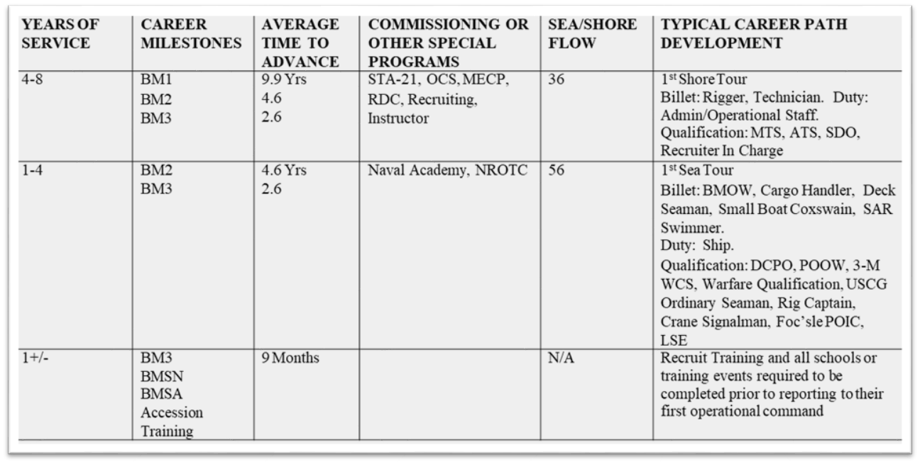
Career Path
Notes:
FACILITATOR GUIDE:
Presenter can elaborate on how using the Career Path and LaDR would be beneficial to planning a successful Career and assisting with increased possibility for Advancement.

Slide 14
Review and Summary
Career Development Boards
Advancement
Commissioning Programs
LaDR
Military Obligation Service (MSO)
Questions?
Notes:
FACILITATOR GUIDE:
Questions to ask the class:
What is the purpose of a CDB? What is the CDB Schedule? What is the PACT CDB Schedule? What paygrades take the NWAE? When is the PMKEE deadline? What is an EAW? What is a Profile Sheet? How many years is your MSO?
Presenter can tailor review questions to the audience.

